Slide 1
Spatial Analysis in R
Vijay Ramesh
SCCS - 2019

Slide 2
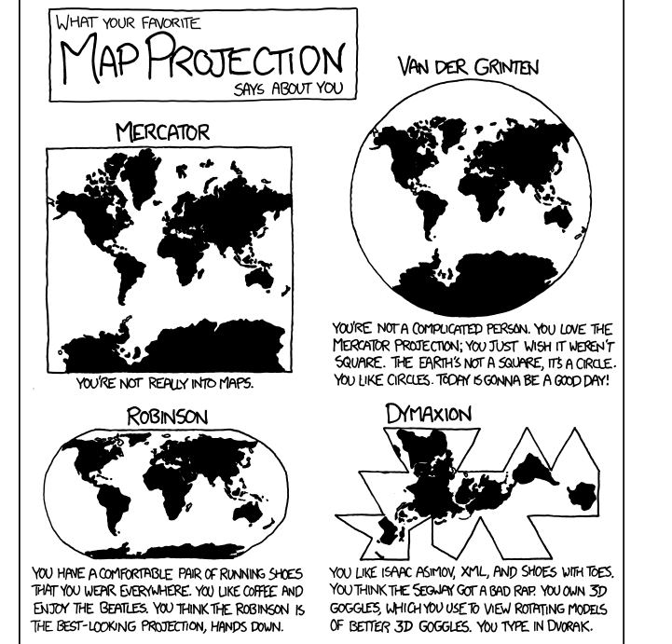
What is the workshop about?
Spatial Analysis – a burgeoning field
Introductions
Outline for the workshop
Getting your hands dirty with some code!

Slide 3
Why Spatial Analysis?
Pattern and Process (Landscape Ecology)
Visualization?
What’s the question you want to answer? Will spatial data or spatial analysis help answer your hypothesis?

Slide 4
Recap: What are Vectors and Rasters?
Vector data tends to dominate the social sciences because human settlements and boundaries have discrete borders.
Raster data often dominates the environmental sciences because these often use remotely sensed imagery.
http://robinlovelace.net/geocompr/spatial-class.html
Image Courtesy: MIT OpenCourseWare
Notes:
Vector data tend to be dominated by points, lines and polygons, whereas raster data is in the form of rows and columns (or a matrix) / grid. / continuous data. Rasters can include elevation models, values for vegetation indices, land cover. Majority of these datasets have attribute tables associated with them.

Slide 5
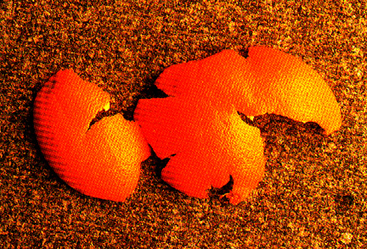
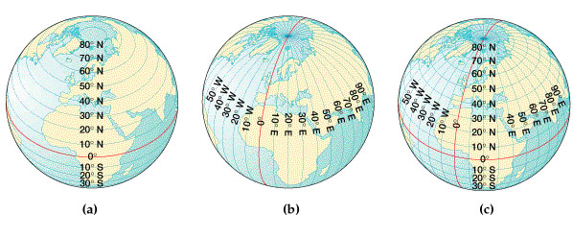
Recap: Coordinate Systems and Transformations
Tradeoffs – Preserve shape or area ?
http://krygier.owu.edu/krygier_html/geog_353/geog_353_lo/geog_353_lo05.html
Notes:
One can look at a geographic grid of the globe and visualize latitude and longitude and the intersection of these lines give you coordinates for a location on the planet (x and y). But globes are not very useful for the reference of mapping, calculating distances etc. Hence, we need a planar surface. There are different types of projections and we would spend way too much time just talking about it, but just to give you an idea that transformation, distorts areas or shapes. Examples include equal area (that preserves area, but distorts shape), Mercator projection that is normally carried out distorts areas, but not shapes [ Geographic coordinate systems are in 3D, spherical – example WGS84; projected coordinate systems use a flat, 2D surface instead]

Slide 6

Why R?
First and foremost, its FREE!
Computationally less intensive (not all the time…☺)
Time efficient
Innovative statistical approaches
Notes:
Why R? As many of might already know, it is free and an advanced environment for statistical analysis – has a variety of statistical and graphical techniques.

Slide 7
Topics to be covered in this Workshop
Spatial Data Visualization – Static and Interactive mapping
Types of Spatial Objects
Spatial Operations
Examples using Climate data, county data and species occurrences [Feel free to use your own data!]

Slide 8
Packages that are useful for Spatial Analysis in R
https://cran.r-project.org/web/views/Spatial.html
getlandsat
rgdal
rgeos
spatialEco (Really cool package!) [If working in the US, you can download monthly gridded PRISM data using this package]
spatstat
maptools
raster
sf

Slide 9
Packages for visualization alone
ggspatial
cartography
tmap
choroplethr
rasterVis
gganimate
mapview
ggiraph
rbokeh – Interactive mapping based on JS libraries
Slide info – courtesy of https://bhaskarvk.github.io/

Slide 10
How are Spatial Objects represented in R?
Spatial objects in R are represented as S4 objects
Basic objects include Points, Lines, Polygons, Pixels and Grids
A class within a class within a class
Slots instead of lists @ → $ → [[]]
For example: map_world@data@attributes[[1]]$NAME
Adapted from Pebesma, sp vignette

Slide 11
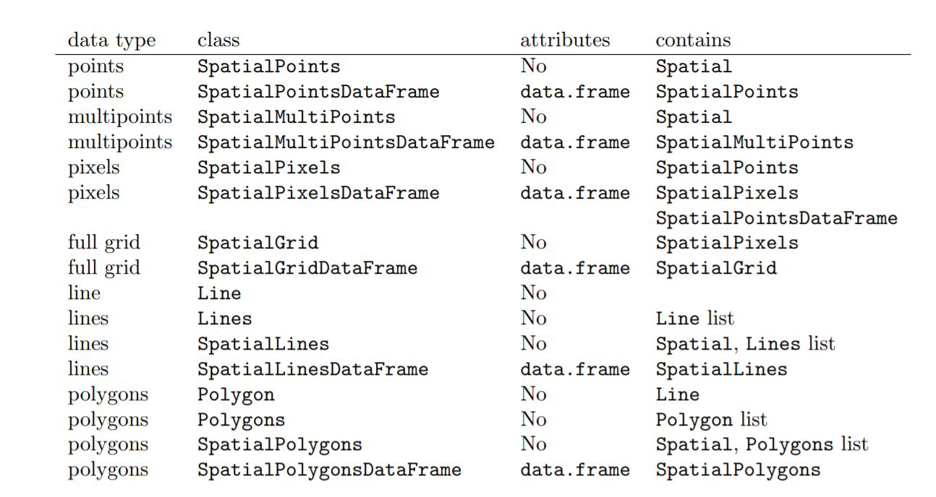

Slide 12
sf is the new sp!
Spatial objects are stored as data frames, with the feature geometries stored in list-columns
All functions begin with st_ for easy RStudio tab completion
Functions are pipe-friendly
dplyr and tidyr verbs have been defined for the sf objects
ggplot2 will soon be able to plot sf objects directly
http://strimas.com/r/tidy-sf/

Slide 13

Using sf – How does it work?
Uses data.frames() and list columns to store geometry
sf functions start with st, sfg is the geometry of a feature
sfc is the list-column of a sf data.frame object containing a list of geometries.
Eg. POLYGON ((30 10, 40 40, 20 40, 10 20, 30 10))
Adapted from useR 2017

Slide 14
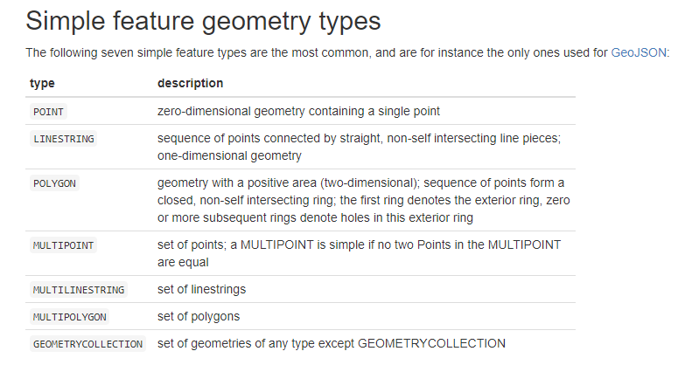

Slide 15
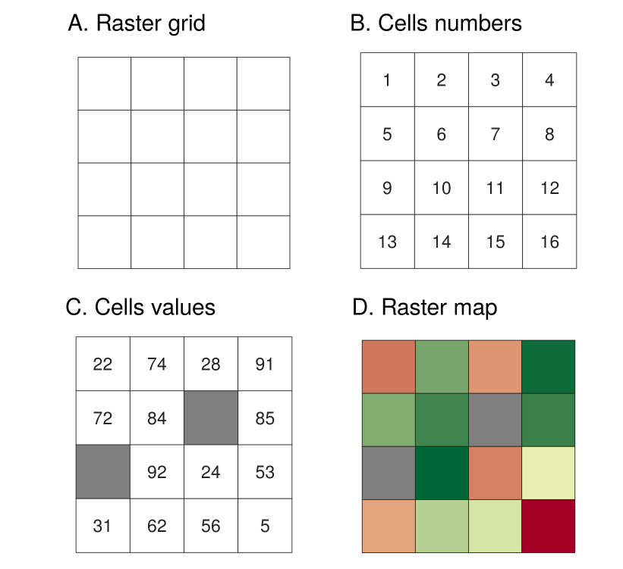
Rasters
http://robinlovelace.net/geocompr/spatial-class.html

Slide 16
Resources for Spatial Analysis in R
https://cran.r-project.org/web/views/Spatial.html - CRAN task View – GOLDMINE!
R-Sig-Geo
Vignettes for different packages
r-spatial.org
NCEAS
GISStackExchange
StackOverflow
NY/NJ SCGIS
https://www.r-spatial.org/

Slide 17
A quick introduction to Git
A version control system for collaboration
Open source
Perfect for sharing code, editing and tracking changes to code
Link to today’s workshop: https://github.com/vjjan91/SpatialAnalysisinR
http://happygitwithr.com/push-pull-github.html

Slide 18
Other resources
ArcGIS-R Bridge - http://proceedings.esri.com/library/userconf/devsummit18/papers/dev-int-179.pdf
stars package in R - https://r-spatial.github.io/stars/ (We won’t have time to cover this today, but all vignettes are available here)
useR conference 2017 presentations - https://gist.github.com/anonymous/3d5b56cb16526db96dcaa0a579980187#file-r_spatial_user-_2017-md

Slide 19
Acknowledgements
Huge shoutout to BhaskarVK - useR! Presentations
GISStackExchange
Brunsdon & Comber
Jeff Evans
All package owners
R

Slide 20
Attribute-Geometry-Relationship in sf
Constant - a variable that has a constant value at every location over a spatial extent; examples: soil type, climate zone, land use
Aggregate - values are summary values (aggregates) over the geometry, e.g. population density, dominant land use
Identity - values identify the geometry: they refer to (the whole of) this and only this geometry.

